Slide 1

IE 6700 Data Management For Analytics Use Case Project Presentation
Group 20
Nithya Rani Vuddagiri
Rajaragunanthan Palanisamy

Slide 2

FIGHT CLUB MANAGEMENT SYSTEM
The plot is from the movie “Fight Club” where two bored men fed up with their mundane lives start an underground fight club and fight other men who participates. We developed the story further by introducing UFC kind of setup, allowing audience space, and betting.

Slide 3
Business Problem
The number of people attending the Saturday evening’s Fight club event keeps on increasing, Tyler Durden has an idea to upgrade the club into an indoor tournament with every information about the fight loaded into a database for easy tracking and to make the data reliable.
He thinks it would be a good idea to allow people to watch the fights as he can earn money from selling tickets as well as a percentage from the betting money.
For this purpose, he needs a Database Management System to be built with automated methods to create, store and retrieve data.

Slide 4
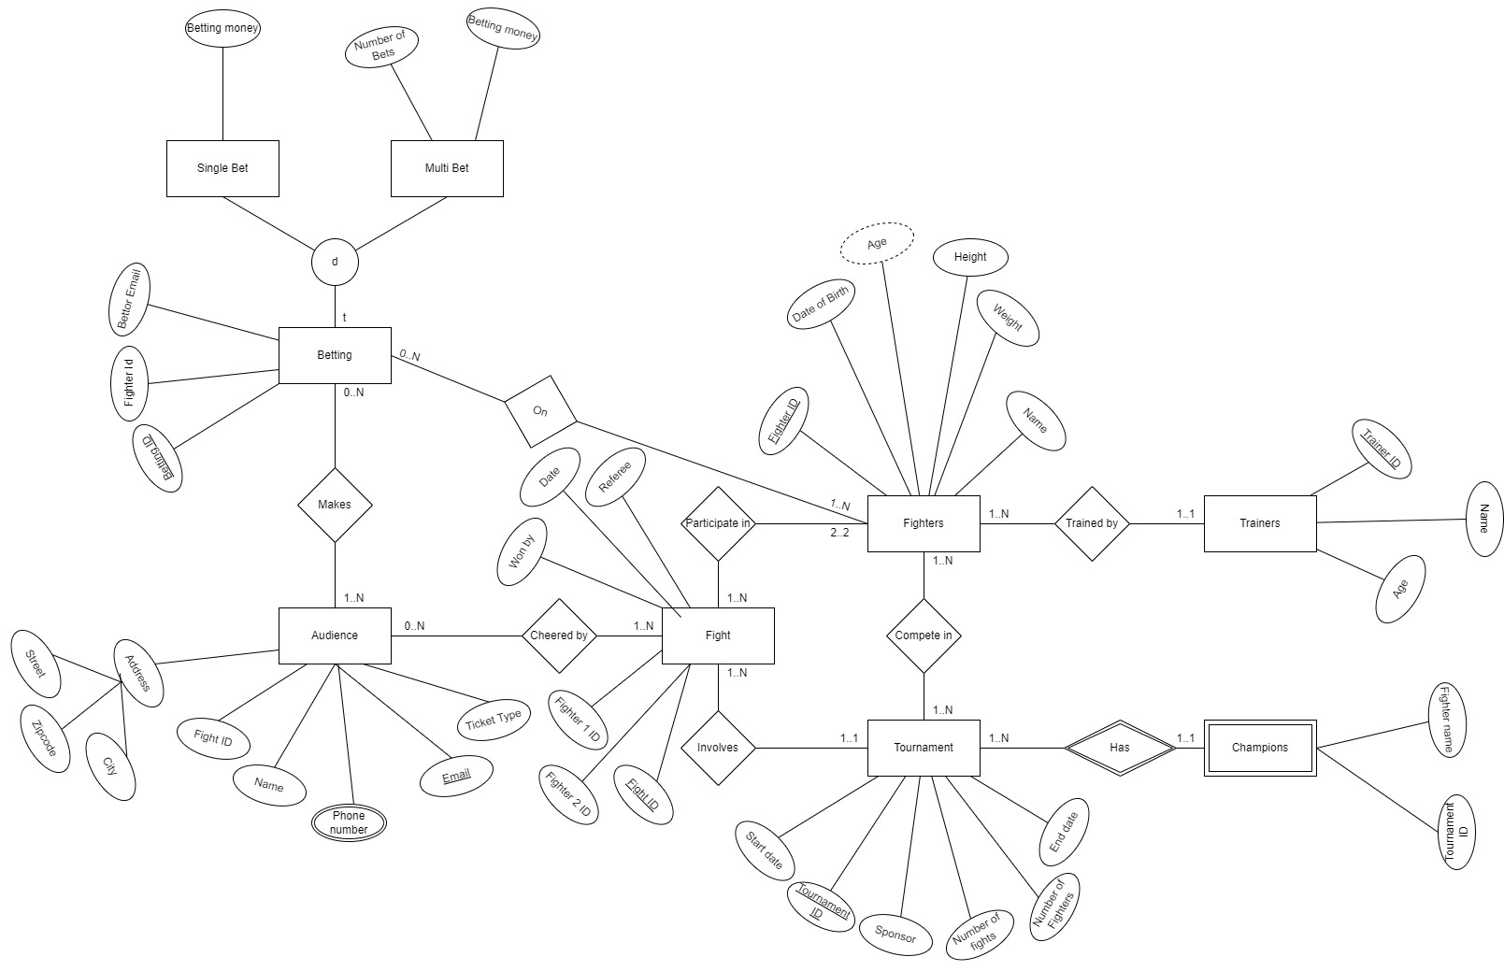
Entity Relationship Diagram (EER)

Slide 5
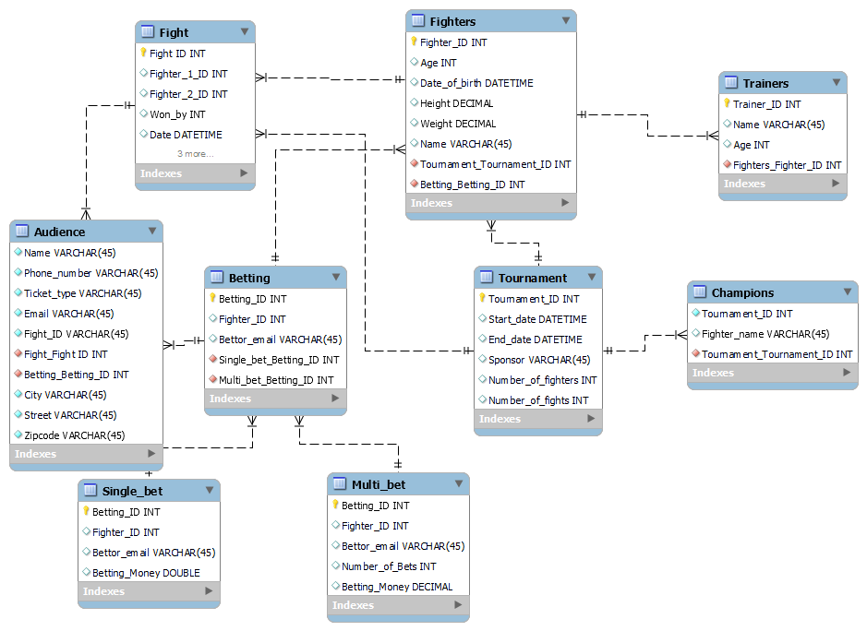
Unified Modelling Language Diagram (UML)

Slide 6
Rules to be followed while implementing
The following rules must be followed while implementing the database:
Each fighter is identified by a unique ID and must have at least and at most one trainer. Name, Age, Date of birth, Height and Weight should be available for a fighter. Name and Age of all the trainers should be stored.
Fighters can participate in tournaments, and each tournament can have 1 to N fights with only two fighters and a referee involving in each fight. Each fight should have a unique Id with fighters involved, winner and date information stored.
The final winner of the tournament will be the champion of the season. Each tournament will have a sponsor and that information should be stored. Start date, end date and other fight information of a tournament should be recorded.
People can get tickets at the counter by specifying their name, phone number, address, email and the fight they want to watch from the list of fights available for that day. Phone number can be multiple. The ticket type can be one of the classes from class-1, class-2 and class-3.
People who have bought the tickets also has an option to bet on the fighters before the commencement of the fight. They can bet on a single player or on multiple players if they have bought tickets for multiple fights on that day.
Bettor email and the fighter on whom he places the bet should be stored. Number of bets data also should be stored in case of multiple bets.
The people who buy tickets for a fight should be uniquely identified by their email ID.

Slide 7
RELATIONAL MODEL (Tables names are bolded; Primary keys are underlined; Foreign keys are in Italics)
Fighters (Fighter_ID, Tournament_ID, Name, Age, Date_of_birth, Height, Weight)
Trainers (Trainer_ID, Name, Age, Fighter_ID)
Tournament (Tournament_ID, Sponsor, Start_date, End_date, Number_of_fights, Number_of_fighters)
Champions (Tournament_ID, Fighter_name)
Fight (Fight_ID, Fighter_1_ID, Fighter_2_ID, Won_by, Date, Referee, Tournament_ID)
Audience (Name, Phone_number, Email, Ticket_type, Fight_ID, Betting_ID , City, Street, Zipcode)
Betting (Betting_ID, Single_bet_betting_id, Multi_bet_betting_id)
Single_Bet (Betting_ID, Fighter_ID, Bettor_Email, Betting_Money)
Multi_Bet (Betting_ID, Fighter_ID, Bettor_Email, Betting_Money, Number_of_Bets)

Slide 8
MY SQL queries
1) Query the Name and the age of fighters who have won the championship so far, order by fighter name
select distinct f.name as Fighter_name, f.Age as Age from champions c inner join tournament t on c.Tournament_ID = t.Tournament_ID inner join fighters f on t.tournament_id = f.tournament_id order by f.name;
2) Write a query to display the fighter names and their trainer names
select t.Name as Trainer_name, f.name as Fighter_name from trainers t inner join fighters f on t.Fighter_ID = f.Fighter_ID;
3) List the Tournament ID and the count for the Tournament that had highest number of fight rounds
select tournament_id, count(*) from fight group by tournament_id having count(*) =
(select max(count) from (select count(*) count from fight group by tournament_id) sub1);
4) Fetch the Ticket_types and their respective Audience counts
select Ticket_type, count(*) as count from audience group by Ticket_type order by Ticket_type;

Slide 9
5) List the Names of the Audience who placed bets on Fighters and their respective Fighter names
select a.name Bettor, fr.name Fighter from audience a inner join fight f on a.Fight_ID = f.Fight_ID inner join fighters fr on f.Won_by = fr.Fighter_ID;
6) Fetch the Bettor name, Id and sum of single bet money for each
select sb.Fighter_ID, a.name Bettor, sum(sb.Betting_Money) Total_money from audience a inner join betting b on a.Betting_ID = b.Betting_ID inner join single_bet sb on b.single_bet_betting_id = sb.Betting_ID group by sb.Fighter_ID, a.name order by sb.Fighter_ID;
7) Fetch the Bettor name, Id and sum of multi-bet money for each
select mb.Fighter_ID, a.name Bettor, sum(mb.Betting_Money) Total_money from audience a inner join betting b on a.Betting_ID = b.Betting_ID inner join multi_bet mb on b.multi_bet_betting_id = mb.Betting_ID group by mb.Fighter_ID, a.name order by mb.Fighter_ID;
8) Show the names of the fighters, referee and tournament_id for each fight
select f1.Name Fighter_1, f2.Name Fighter_2, f.Referee Referee, f.Tournament_ID from fight f left outer join fighters f1 on f.Fighter_1_ID = f1.Fighter_ID left outer join fighters f2 on f2.Fighter_ID = f.Fighter_2_ID;

Slide 10
No-SQL (cypher queries)
1) Fetch the average weight of all the fighters with age >=30 who are also champions
match (f:Fighter) -[:Participates_in]-> (t:Tournament) <-[:of_the]- (c:Champion)
where f.age>=30
return avg(f.weight) as Average_weight
2) Return the Participation date in tournament for the fighter ‘Tom’
match (c:Champion) -[:of_the]-> (t:Tournament)
where c.fighterName = 'Tom'
return t.startDate as Participation_date
3) Return the count of fighters who are trained by trainers of age equal to 50
Match (t:Trainer) -[:Trains]-> (f:Fighter)
where t.age = 50
return count(f) as count_of_fighters

Slide 11
Python accessing the Database
To perform Statistical Analysis, Transformations and Visualizations

Slide 12
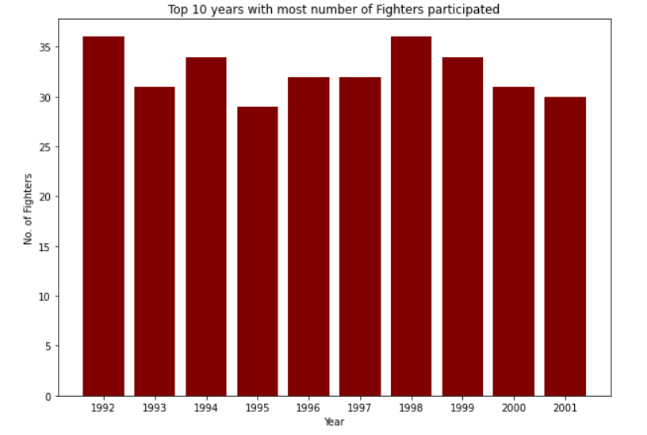
Plot-1
A plot that show the Top 10 years with x-axis ordered by years having the most number of fighters participated

Slide 13
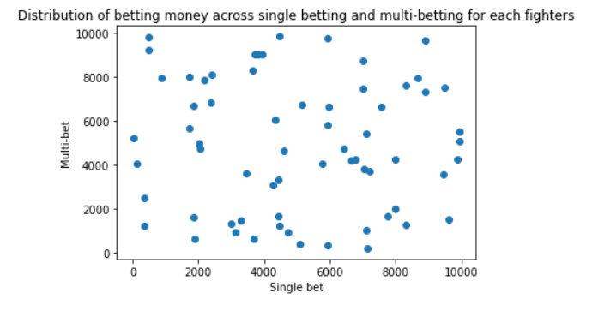
Plot-2
A scatter plot showing the distribution of money on both single and multi-bets for all the fighters

Slide 14
Tableau access
For interactive visualizations

Slide 15
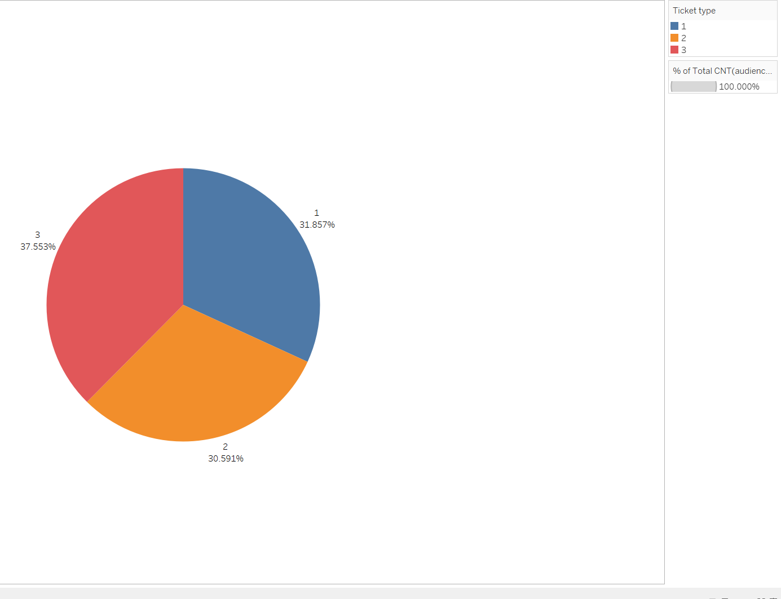
Plot-3
A pie chart showing the percentage of people who bought tickets on 3 ticket types – 1st , 2nd , and 3rd classes.

Slide 16
THE END

